Slide 1
NASP® Works
for Students, Conservation & the Shooting Sports

Slide 2
During this presentation
Describe Recent NASP® Survey
Recruitment
Student Impacts
Conservation Impacts
Shooting Sports Impacts
Retention & Reactivation
Alumni Association

Slide 3
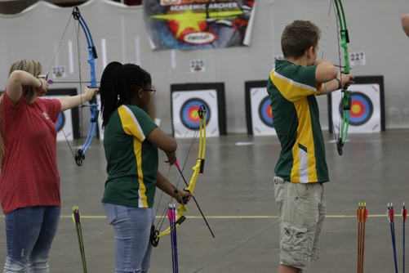
NASP® Mission
Unchanged for 18 Years
NASP® promotes international-style target archery as part of in-school curriculum, to improve educational performance and participation in the shooting sports among students in grades 4-12.

Slide 4
2017 NASP® Student Survey

Slide 5
During the survey development process, NASP® collaborated with:
Leadership and staff of the Kentucky Department of Fish and Wildlife Resources
Leadership and staff of Responsive Management
Mr. Wayne Young Executive Director of the Kentucky Association of School Administrators.

Slide 6
Methodology
The 16-question survey was emailed to all BAIs on April 4, 2017 and closed on June 1, 2017.
6,715 responses were collected.
The margin of error for this sample size is well within a +/- 2% margin of error that the perceptions gathered from the 6,715 respondents accurately reflects those of the current 2.43 million NASP® students.
There is a 99% likelihood that our collected data sample fairly and accurately reflects the attitudes of the total population of potential respondents for this survey.

Slide 7
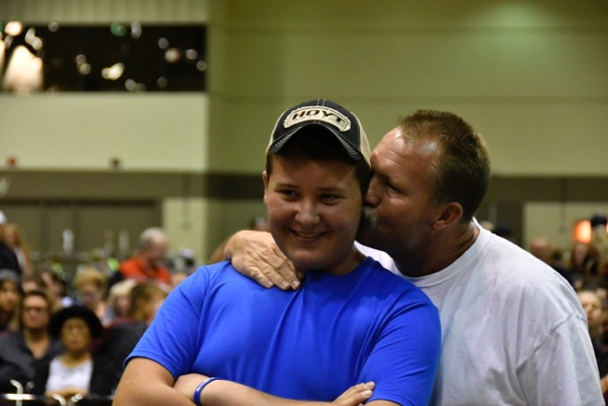
NAsP® Impacts Students

Slide 8
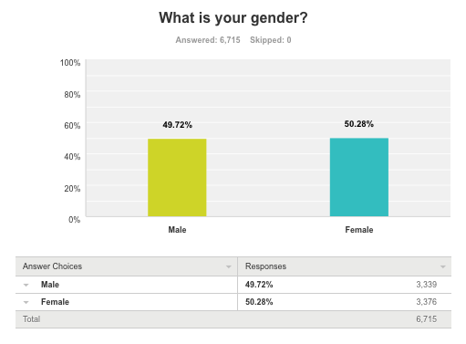
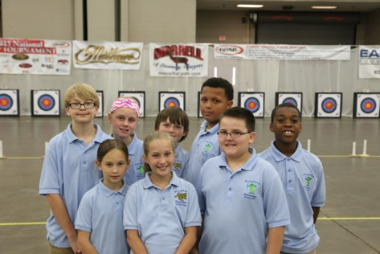
~50:50
52/48 KY
Note: This Ratio is generally reflective of current NASP® participants.

Slide 9
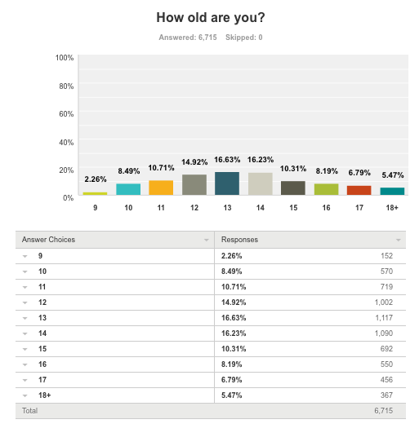
Ages 11-15
Most Prevalent

Slide 10
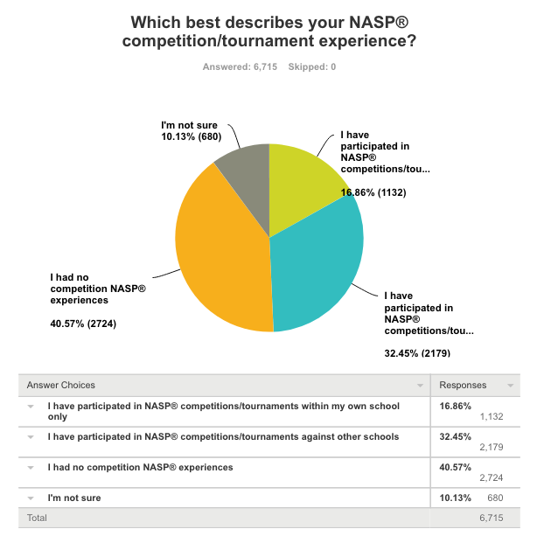
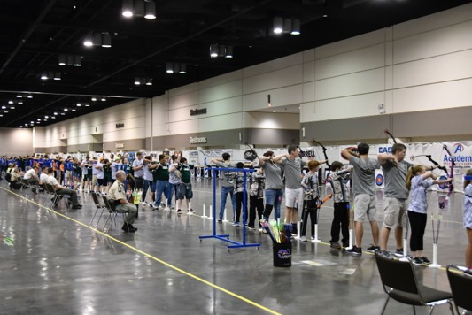
NASP® NATIONALS @ 14,908 KIDS
IS WORLD’S LARGEST
41% No Competitive Experience
(18% KY)

Slide 11
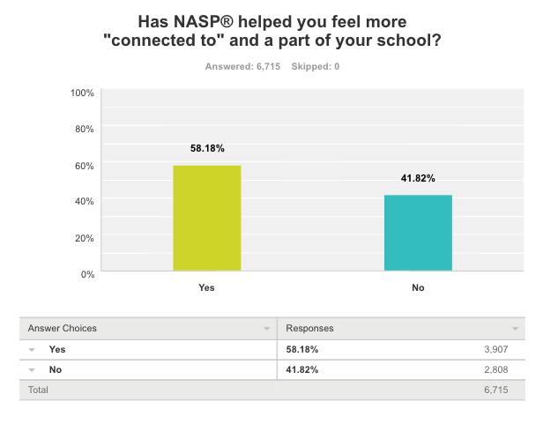
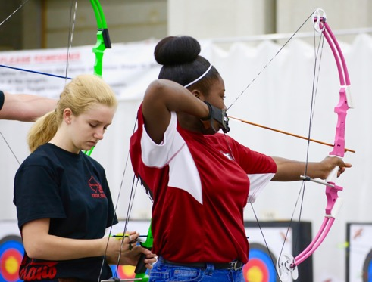
58.18%
Connected
70% KY

Slide 12
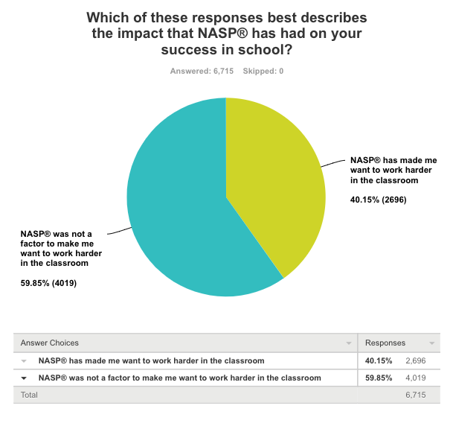
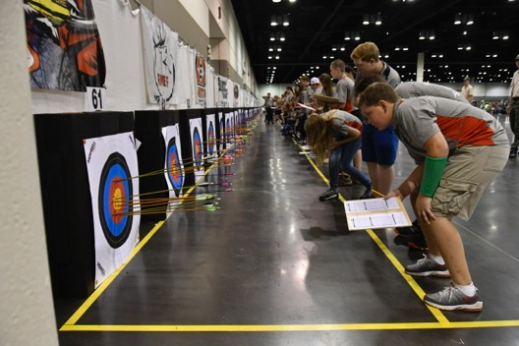
40.15%
Work Harder
45% in KY

Slide 13
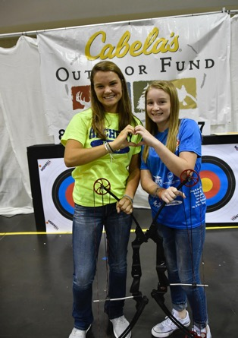
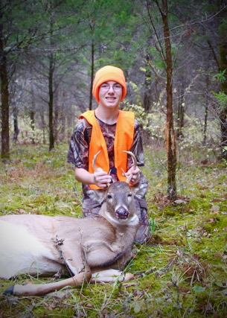
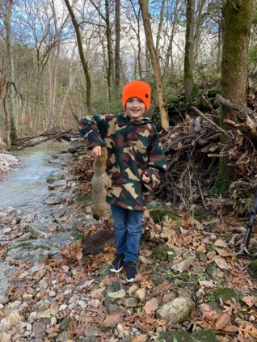
NASP® Works for Conservation & the shooting Sports

Slide 14
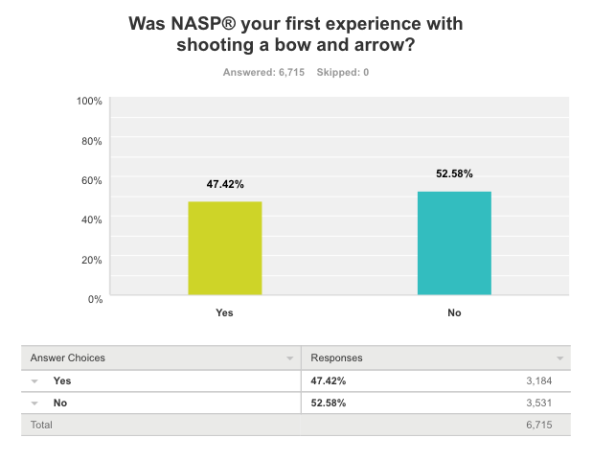
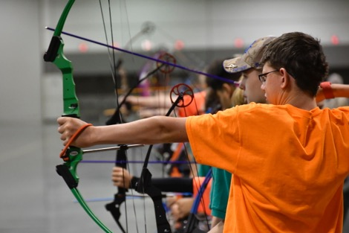
47.42%
49% KY

Slide 15
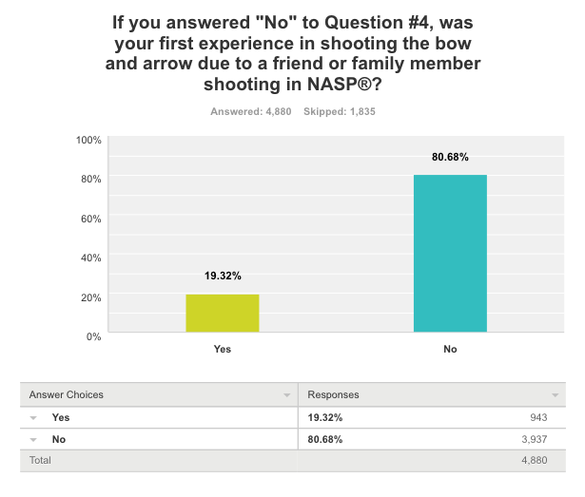
19.3%
20% said friend or family in NASP® started them shooting

Slide 16
Another 18.45% said a family member became an archer because of the student being in NASP®
(38.38% in KY)

Slide 17
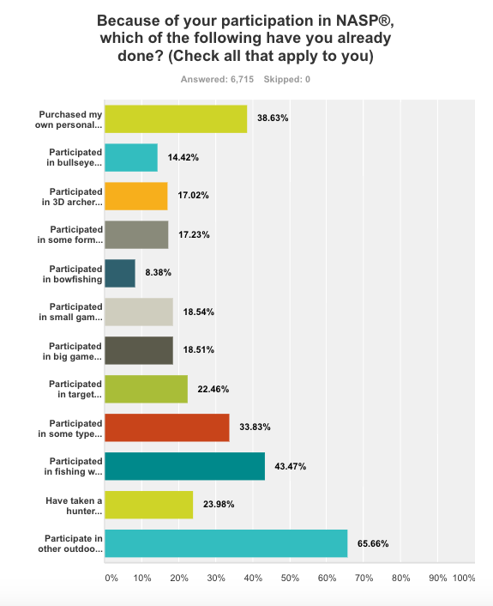
Non-NASP BOW
39% - 56%
19%
43%
Fishing
24%
Hunter ED

Slide 18
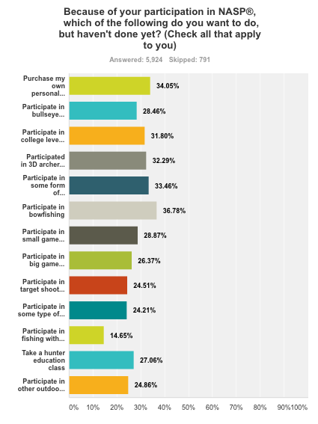
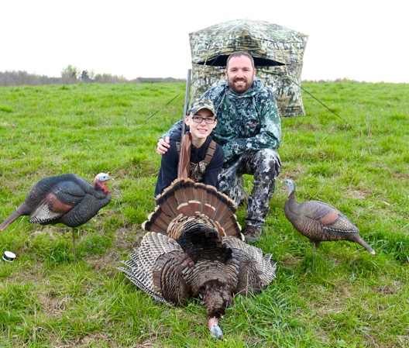
34% - 17%
27%
27%

Slide 19
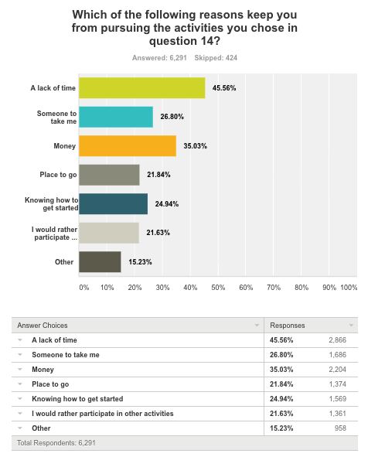
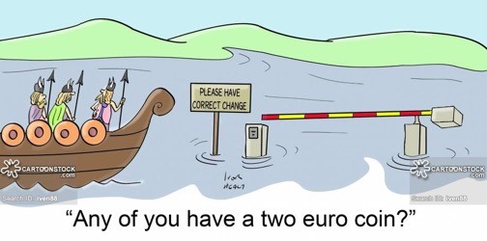
Barriers to Participation
No Time
Need Mentor
Money
Place to Go
Lack Knowledge
Other Priority

Slide 20
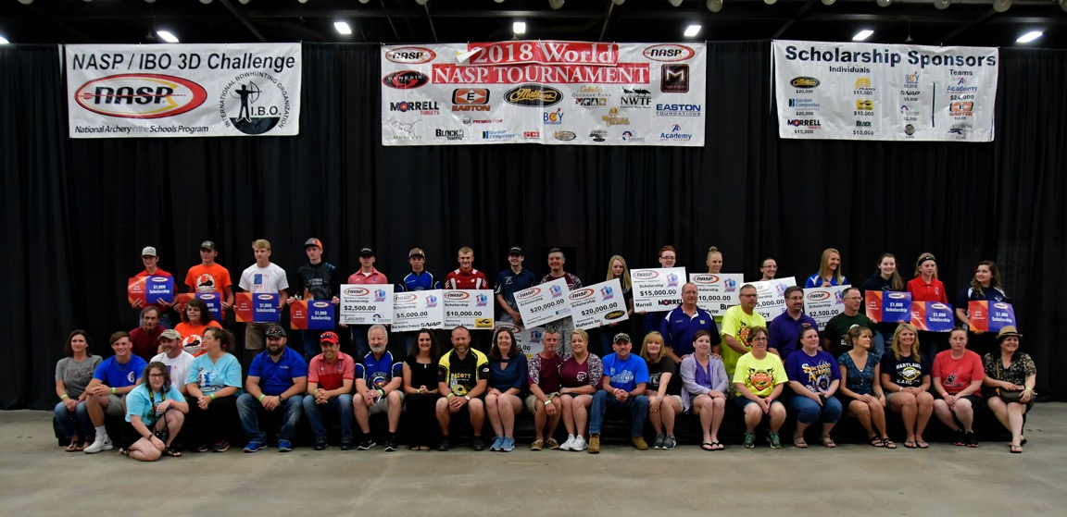
$1.8 Million in CASH Scholarships

Slide 21
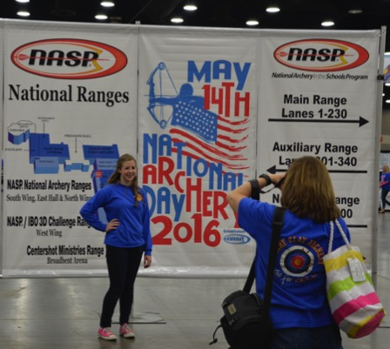
During this presentation we…
Described NASP®’s Mission
Explained our Survey
Shared Outcomes as Stated by Participants

Slide 22
Thank-You!
NASP® Sponsors

