Slide 1
NRA… Friends of NRA… NRA Foundation… R3 and Grant Opportunities
John A. LaRowe
NRA Senior Field Representative, Kentucky

Slide 2
NRA… Founded in 1871… 501c4 Membership Organization… …to "promote and encourage rifle shooting on a scientific basis,"

Slide 3
Friends of NRA… Grassroots Volunteer Organization Local Presence of The NRA Foundation Primary Role to Generate Funds for Grants ~24 Teams Across Kentucky $632K Raised in 2018

Slide 4
NRA Foundation… 501c3 Charitable Organization Founded in 1992 Generated $64M for 2019 Grants ~1150 Chapters Nationwide Target constituencies: “…children, youth, women, individuals with physical disabilities, gun collectors, law enforcement officers, hunters and competitive shooters.”

Slide 5
R3 Opportunities **NEW**On Line Hunter Education Huge Variety of Shooting Sports Programs YHEC

Slide 6
Grant Opportunities NRA Foundation/KY State Fund Grants

Slide 7
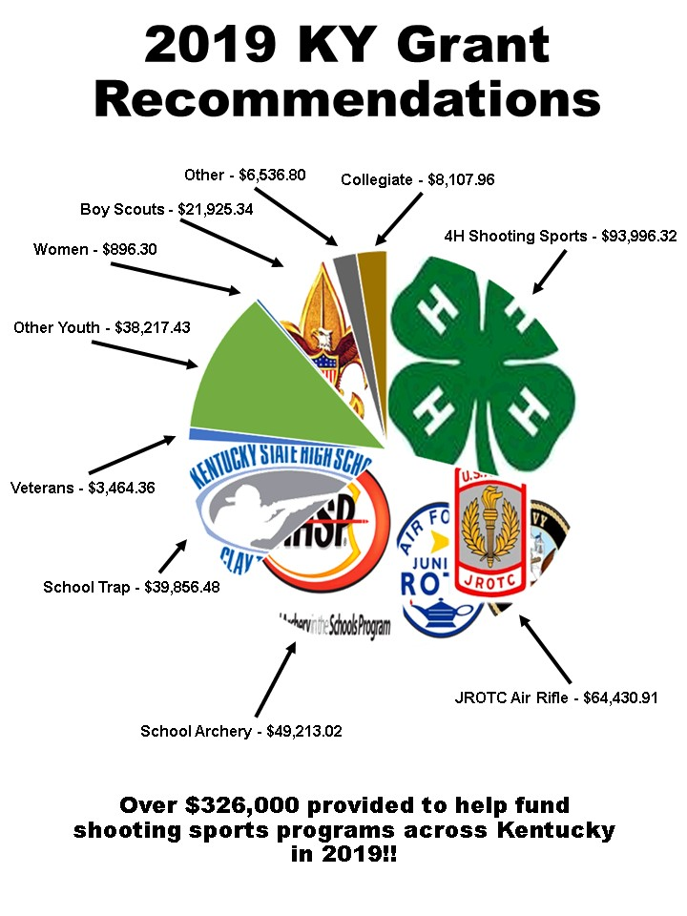

Slide 8
Grant Opportunities Public Range Grants Property MUST be Owned by Public Entity Up to $25,000 per Year Matching Funds Year-Round Applications

Slide 9
Questions?

